Slide 1
Architecture & Fusion Eval

Slide 2
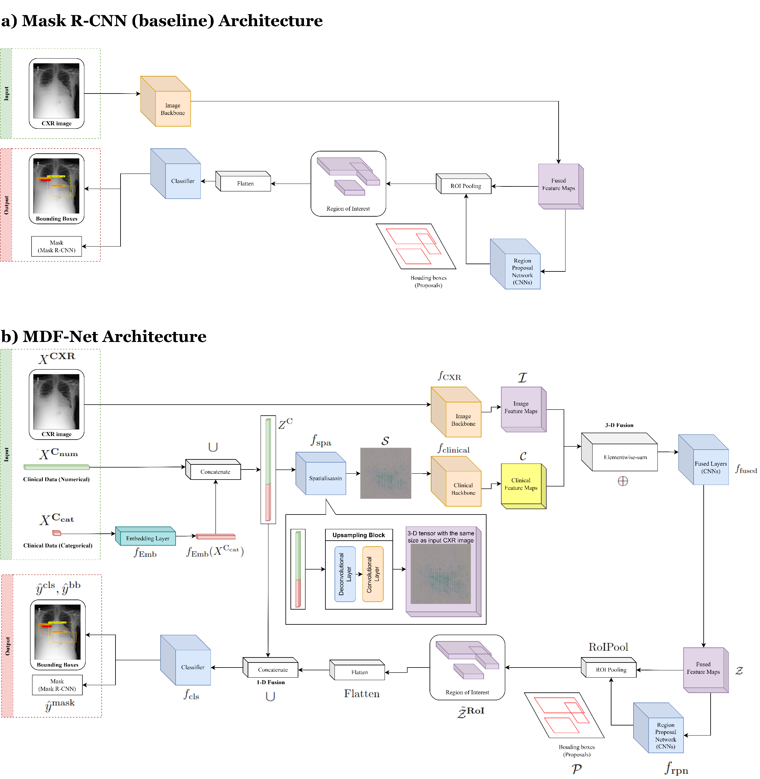
Baseline Model

Slide 3
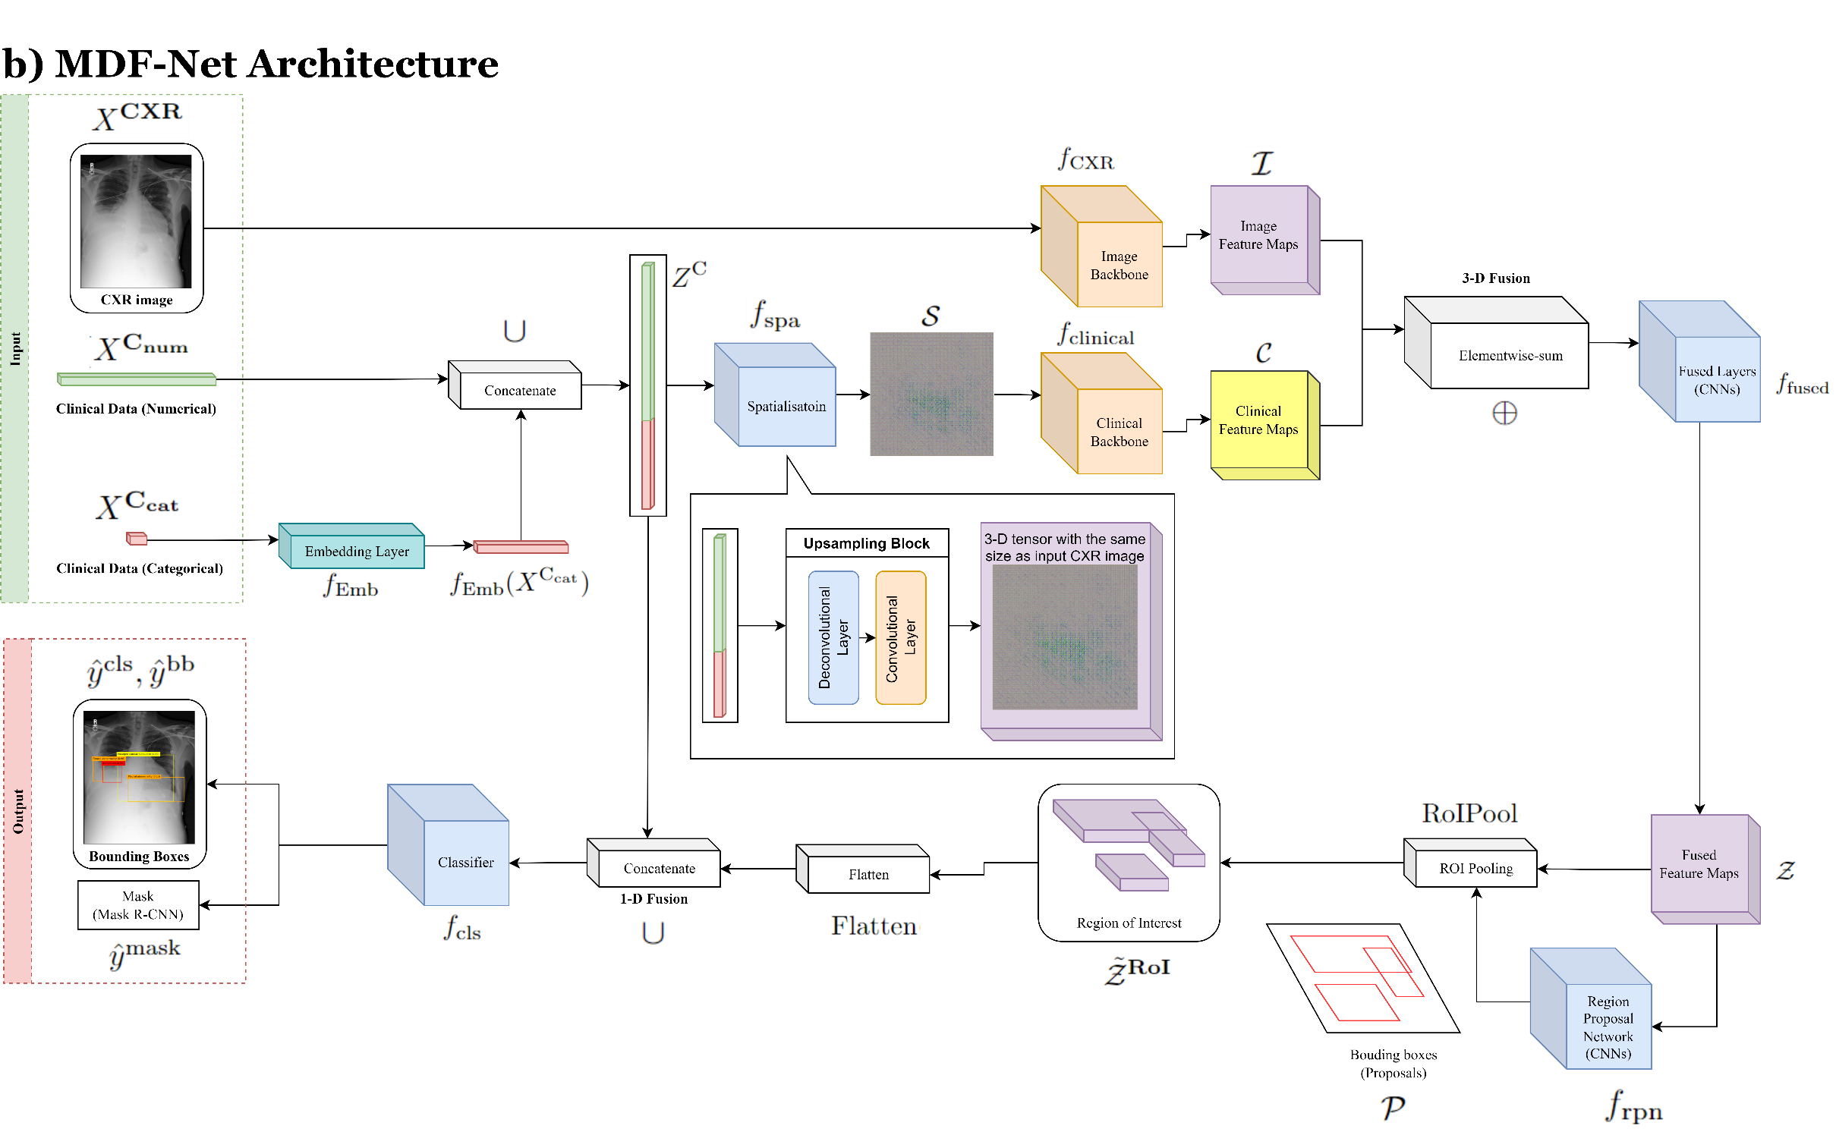

Fusion Methods
clinical_mobilenet_sum
clinical_mobilenet_hadamard
clinical_mobilenet_concat_conv
clinical_mobilenet_concat_linear

Slide 4

Fusion Block vs Just Fusion Layer
clinical_mobilenet_concat_conv
clinical_mobilenet_concat_convb

Slide 5

Backbone vs without backbone
clinical_mobilenet_concat_conv
clinical_mobilenet_concat_conv_nb

Slide 6

Spatialisation Methods
clinical_mobilenet_concat_conv (deconv)
clinical_mobilenet_concat_conv_inter (interpolate to upsample)
clinical_mobilenet_concat_conv_repeat

